Slide 1
Social Structure and Politics
The influence of class on political representation in ancient Athenian democracy.

Slide 2
Refresher
Democracy: (Demos) ‘People’ (Kratos) ‘Power’.
Power: The ability to direct or influence the behavior of others or the course of events.
Class: (social structure) The system of ordering a society in which people are ranked based on social or economic status.

Slide 3
Rights and Responsibilities
Rights: A moral or legal entitlement to have something or to act in a certain way. What is a right you have?
Responsibilities: Things one must do as part of a job, role, or legal obligation. What is a responsibility you hold?

Slide 4
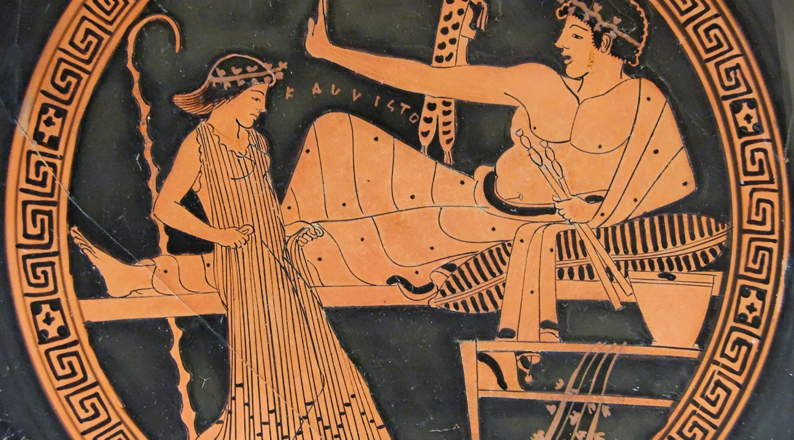
Slaves
Recall the rights you thought off. Would a slave have these rights? Now think about your responsibilities. What responsibilities would a Athenian slave have?

Slide 5
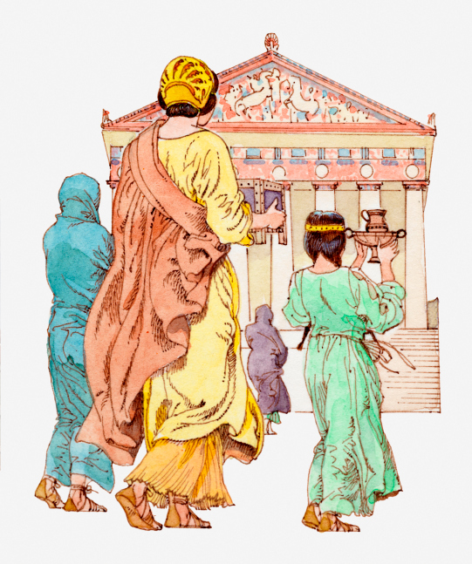
Children
Boys: Went to school, had military training,
And helped in a family businesses.
Would you have liked
to grow up in
ancient Greece?
Girls: Learned household skills like cooking
as well as dance and other forms of art.

Slide 6
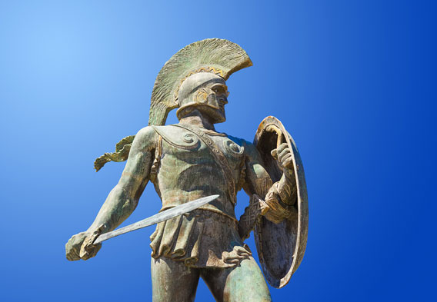
Men
Citizens:
Free, born in Athens from parents born in Athens
Expected to vote, serve in government, and go to war.
Metics:
Immigrants, needed sponsorship from a citizen
Could not buy land or vote

Slide 7
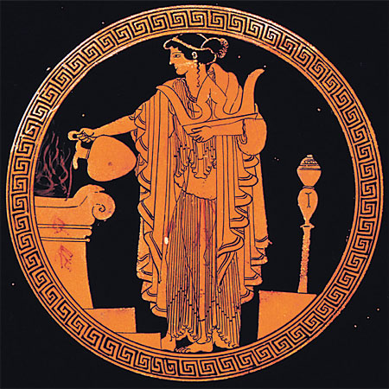
Women
Women were caregivers and house keepers, though some had other jobs, such as the priestess in this painting.
Women could own land, but only if they were born in Athens.

Slide 8
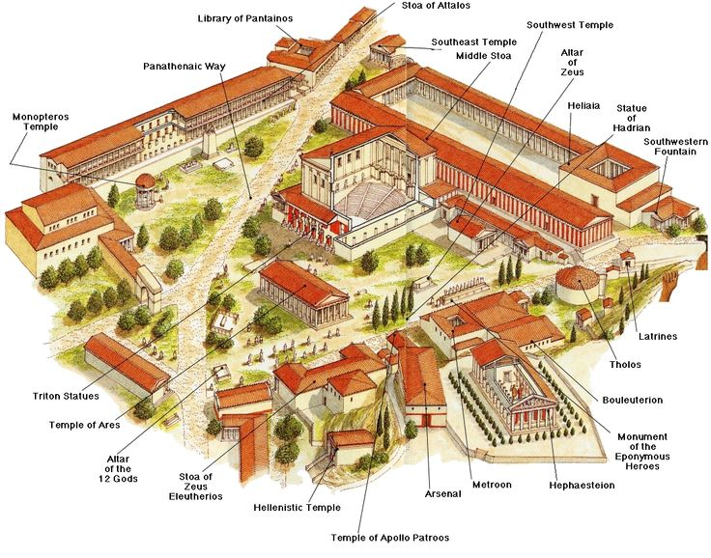
Agora

Slide 9
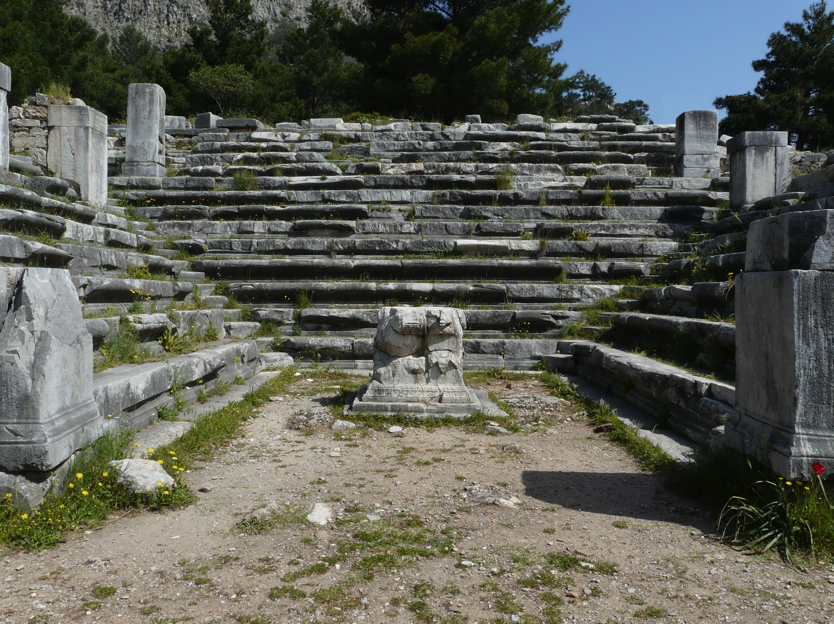
Bouleuterion

